Slide 1
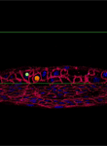
Embryonic development
AEHBY Human Biology

Slide 2
Review
Draw a zygote, morula and blastocyst. (3)
Which type of stem cells are totipotent, pluripotent and multipotent? (3)
List these in developmental order: spermatozoa, primary spermatocyte, spermatogonia, secondary spermatocyte (4)
Briefly describe the function of the prostate gland? (3)

Slide 3
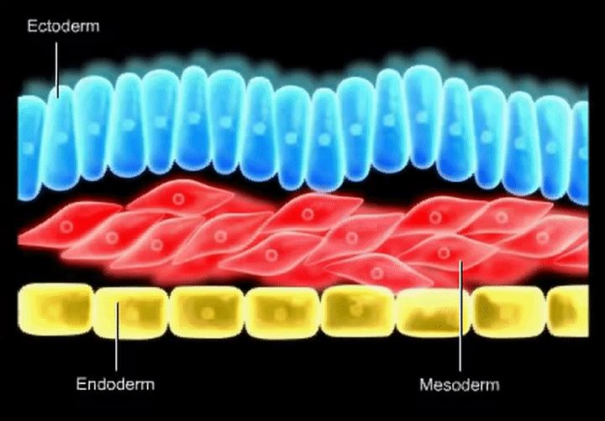
Learning Intentions
The development of the embryo after implantation involves the differentiation of cells into three different germ layers that will eventually produce specific systems in the body and the placenta

Slide 4
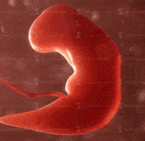
Success criteria
Define and describe gastrulation.
Give examples of tissues that arise from the three primary germ layers (ectoderm, mesoderm, endoderm).

Slide 5
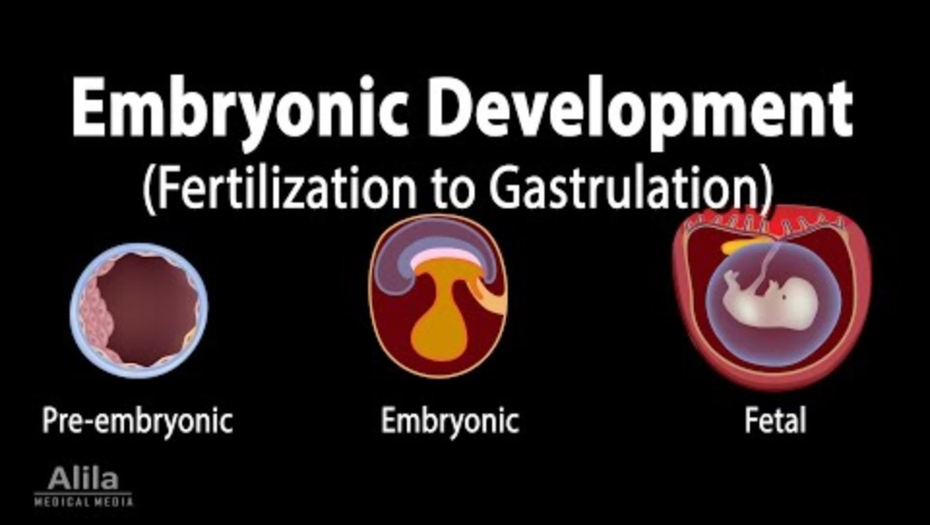

Slide 6
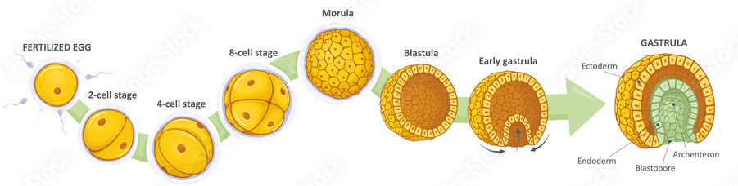
Embryonic stage
While implantation is occurring, gastrulation converts the blastocyst into an embryo. The three embryonic layers, embryonic membranes and amniotic fluid form.

Slide 7
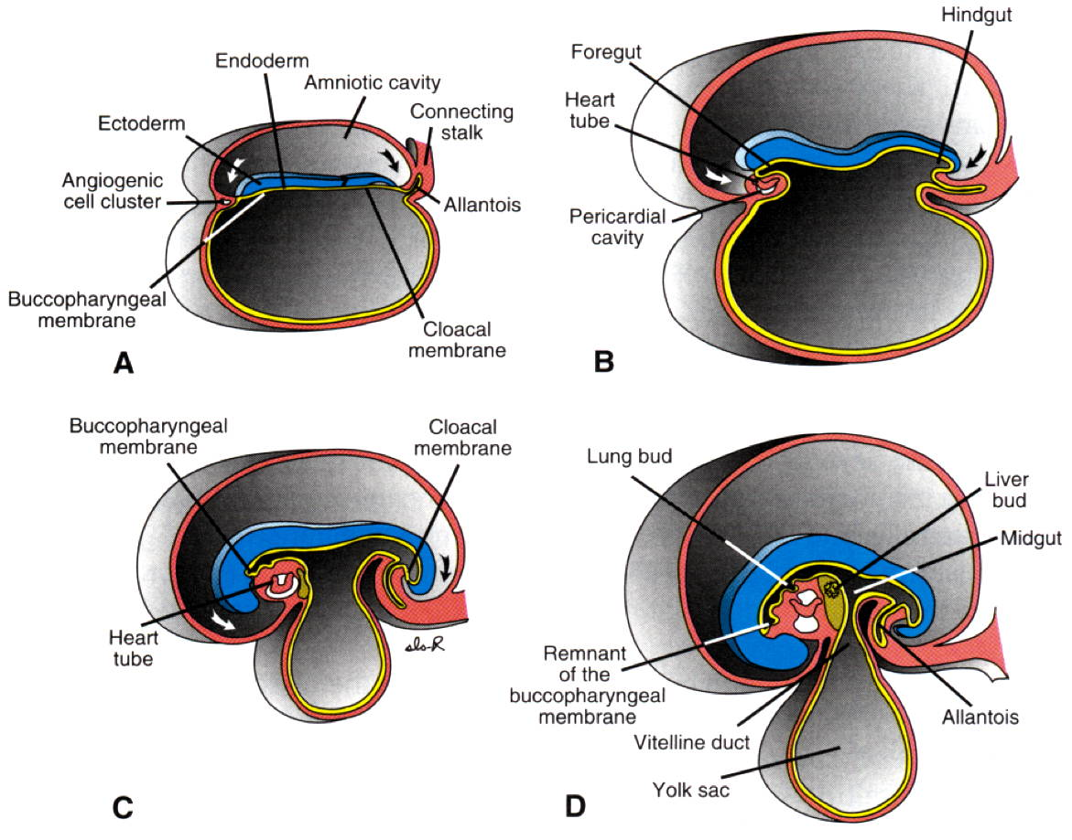

Slide 8
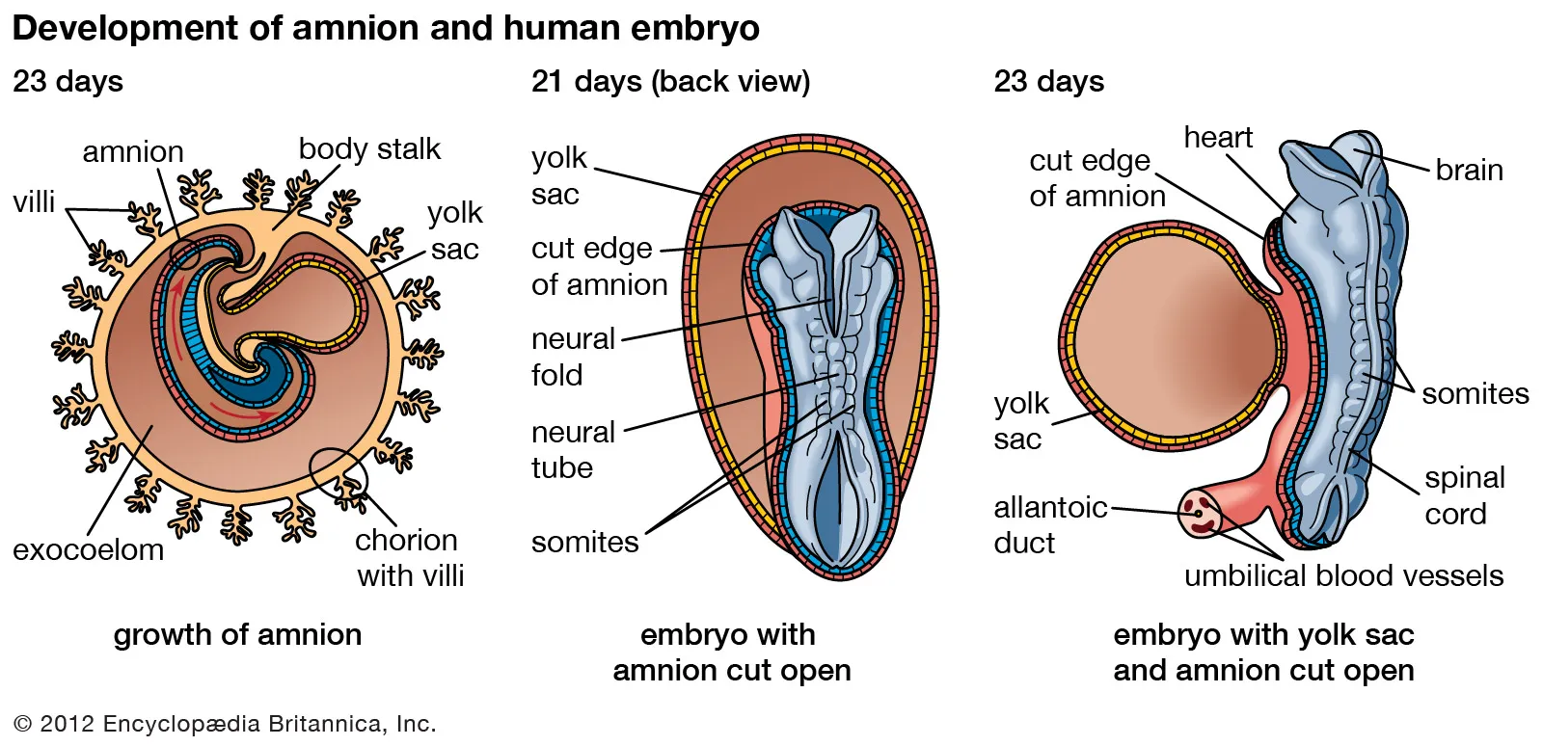

Slide 9
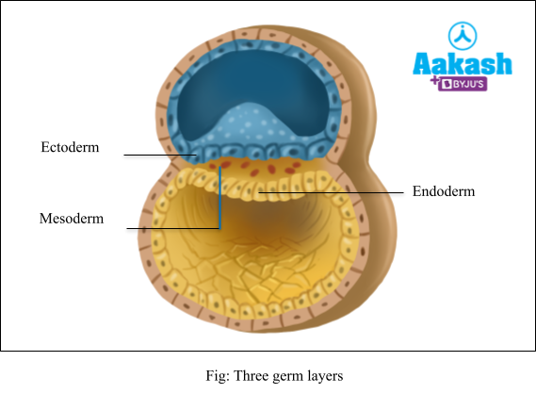

Slide 10
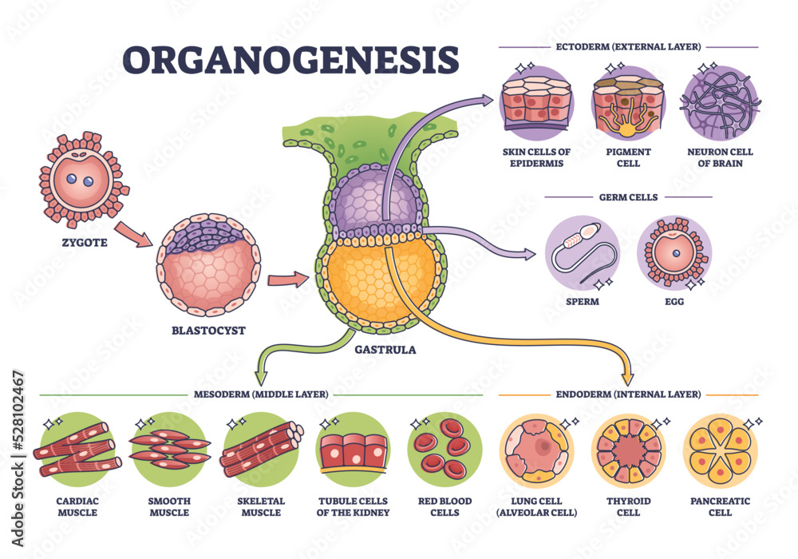

Slide 13
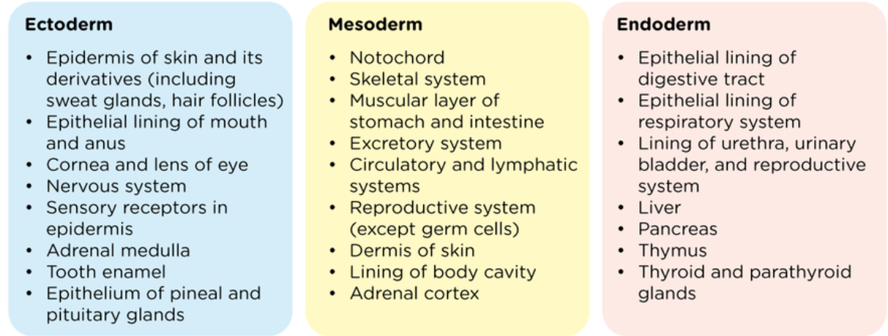

Slide 18
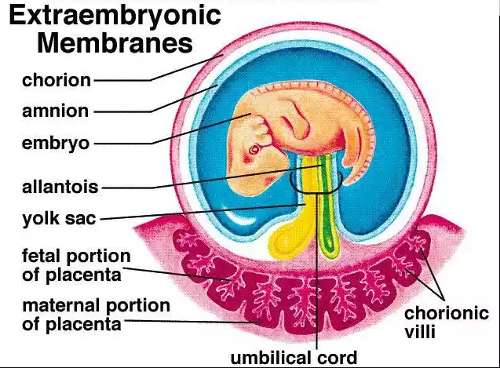
Embryonic membranes
Amnion – contains and secretes amniotic fluid
Chorion – eventually becomes part of the foetal side of the placenta
Yolk sac and allantois – eventually form the umbilical cord

Slide 19
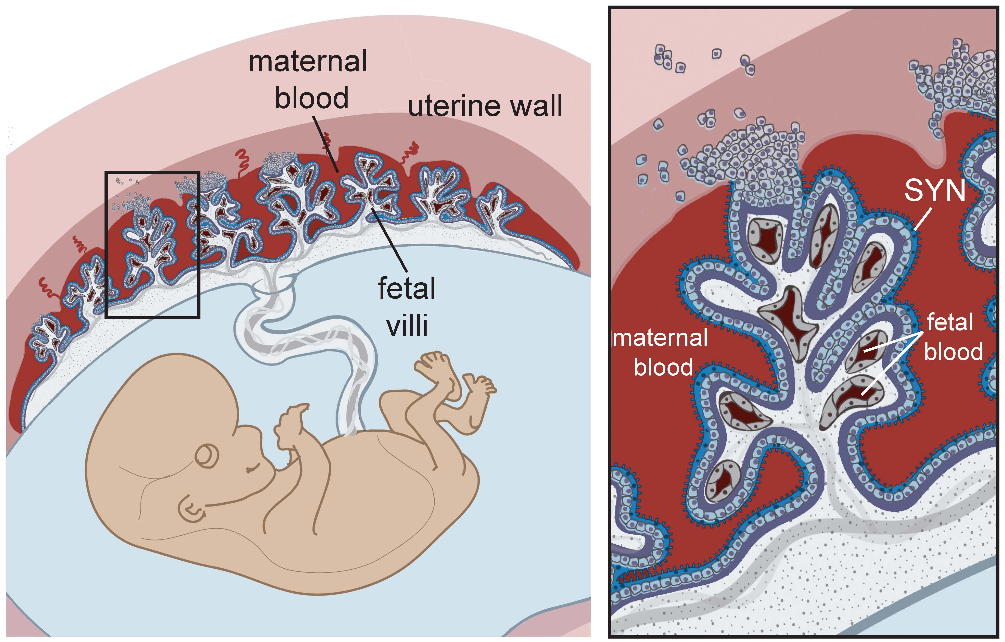
The placenta
The placenta forms from both embryonic and maternal tissues during the first 12 weeks after fertilisation.
In addition to supplying nutrients and oxygen, and removal of wastes, the placenta produces hormones to maintain the pregnancy.

Slide 20
The placenta

Slide 21

The placenta
Maternal blood does not mix with foetal blood, although substances can pass across the membranes that form the barrier between the two.

Slide 22
Success criteria
Define and describe gastrulation.
Give examples of tissues that arise from the three primary germ layers (ectoderm, mesoderm, endoderm).

